Slide 1
Natural Language Processing and
Speech Recognition

Slide 2
Introduction to Natural Language Processing

Slide 3

Understand what is natural language processing
Learn about the applications of natural language processing
Discuss popular natural language processing models in practice
Understand the challenges in natural language processing implementation

Slide 4
Introduction to Natural Language Processing

Slide 5


Natural Language
Natural language refers to the language used by humans for communication, which includes spoken and written forms of communication.
A natural language spontaneously develops in human communities through organic processes like usage, repetition, and evolution.
This evolution occurs without intentional planning or premeditation.

Slide 6
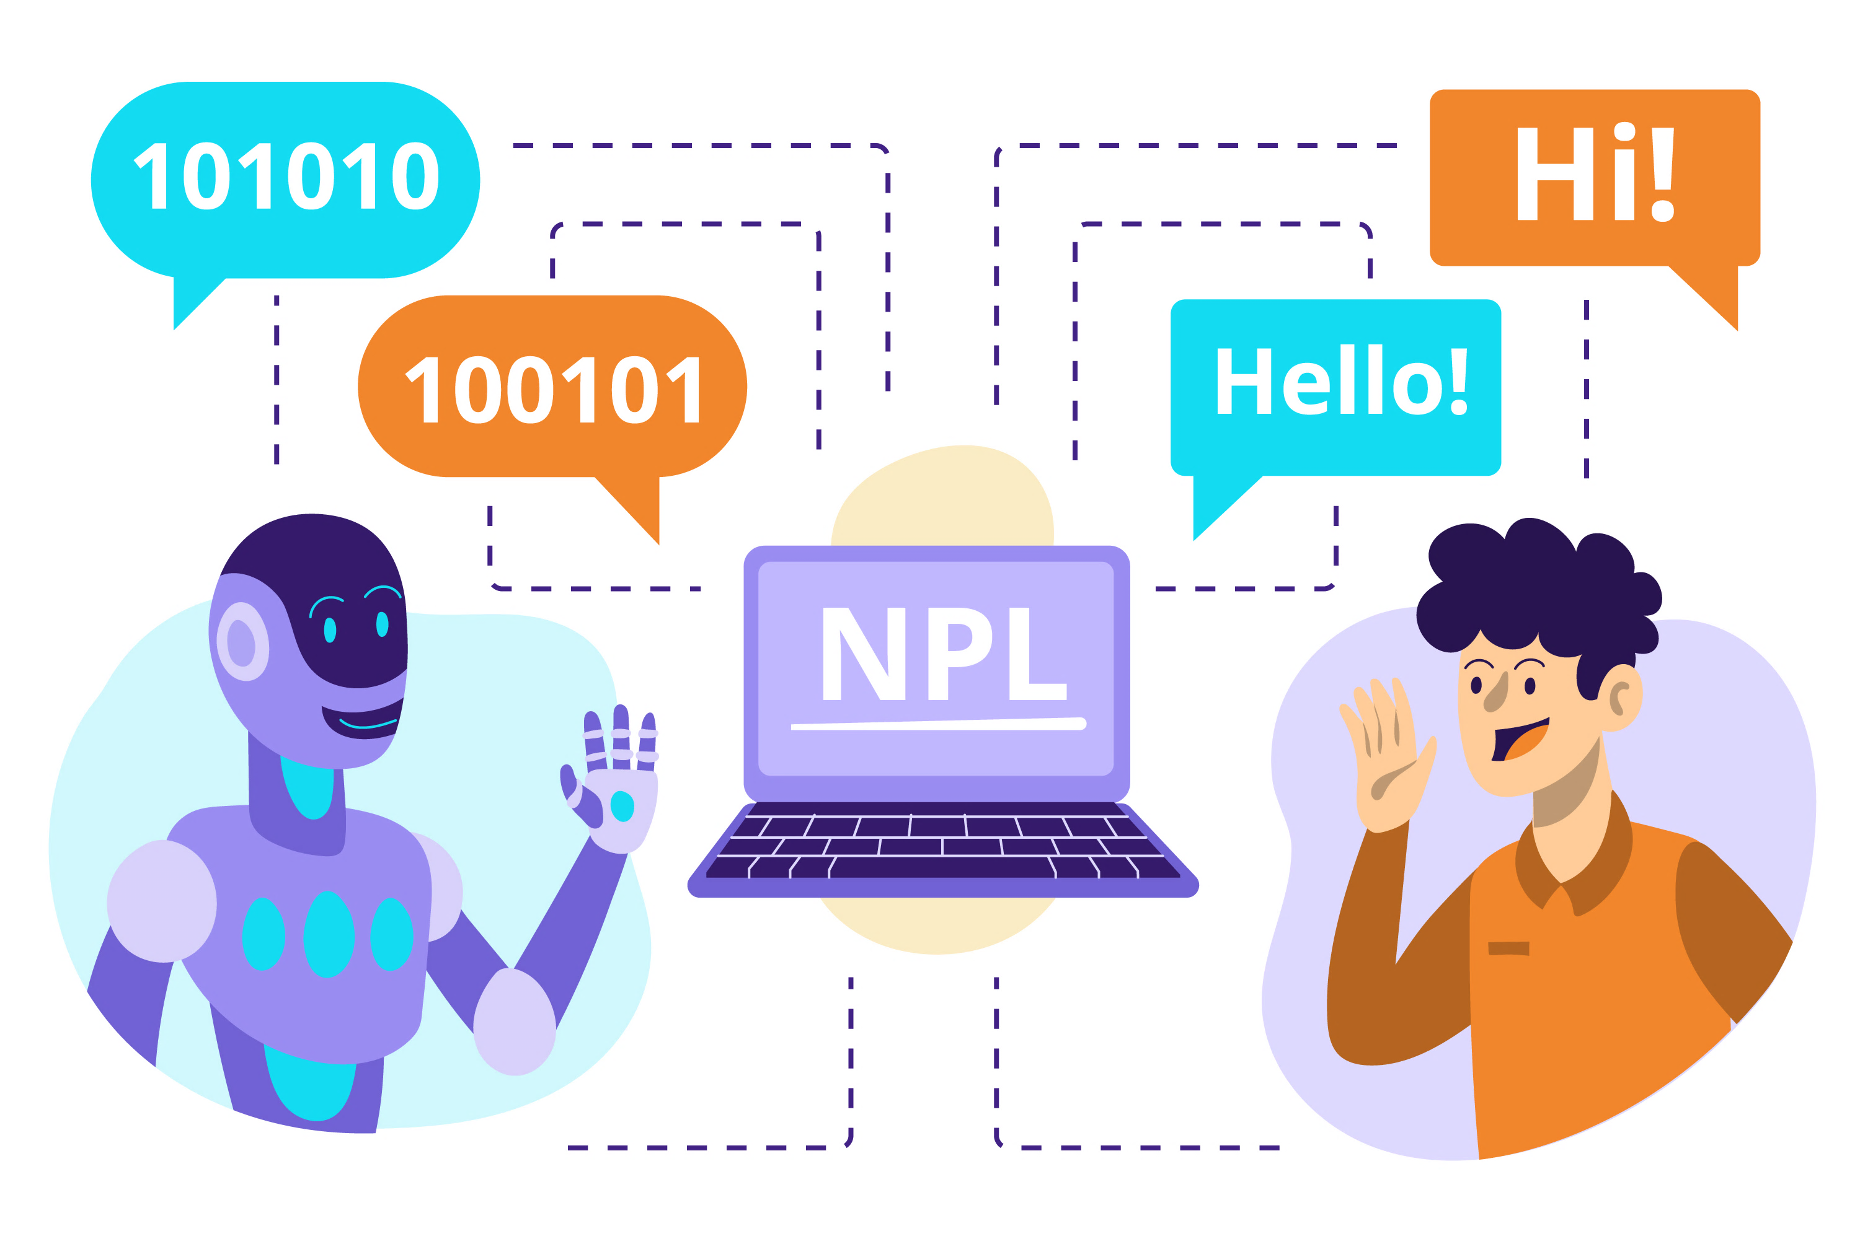
What Is Natural Language Processing?
Natural Language Processing (NLP) is a specialized branch of AI that focuses on interaction between computers and human language.
The primary goal of NLP is to enable machines to understand, interpret, and generate human-like text.
This enables effective communication between people and computers.

Slide 7
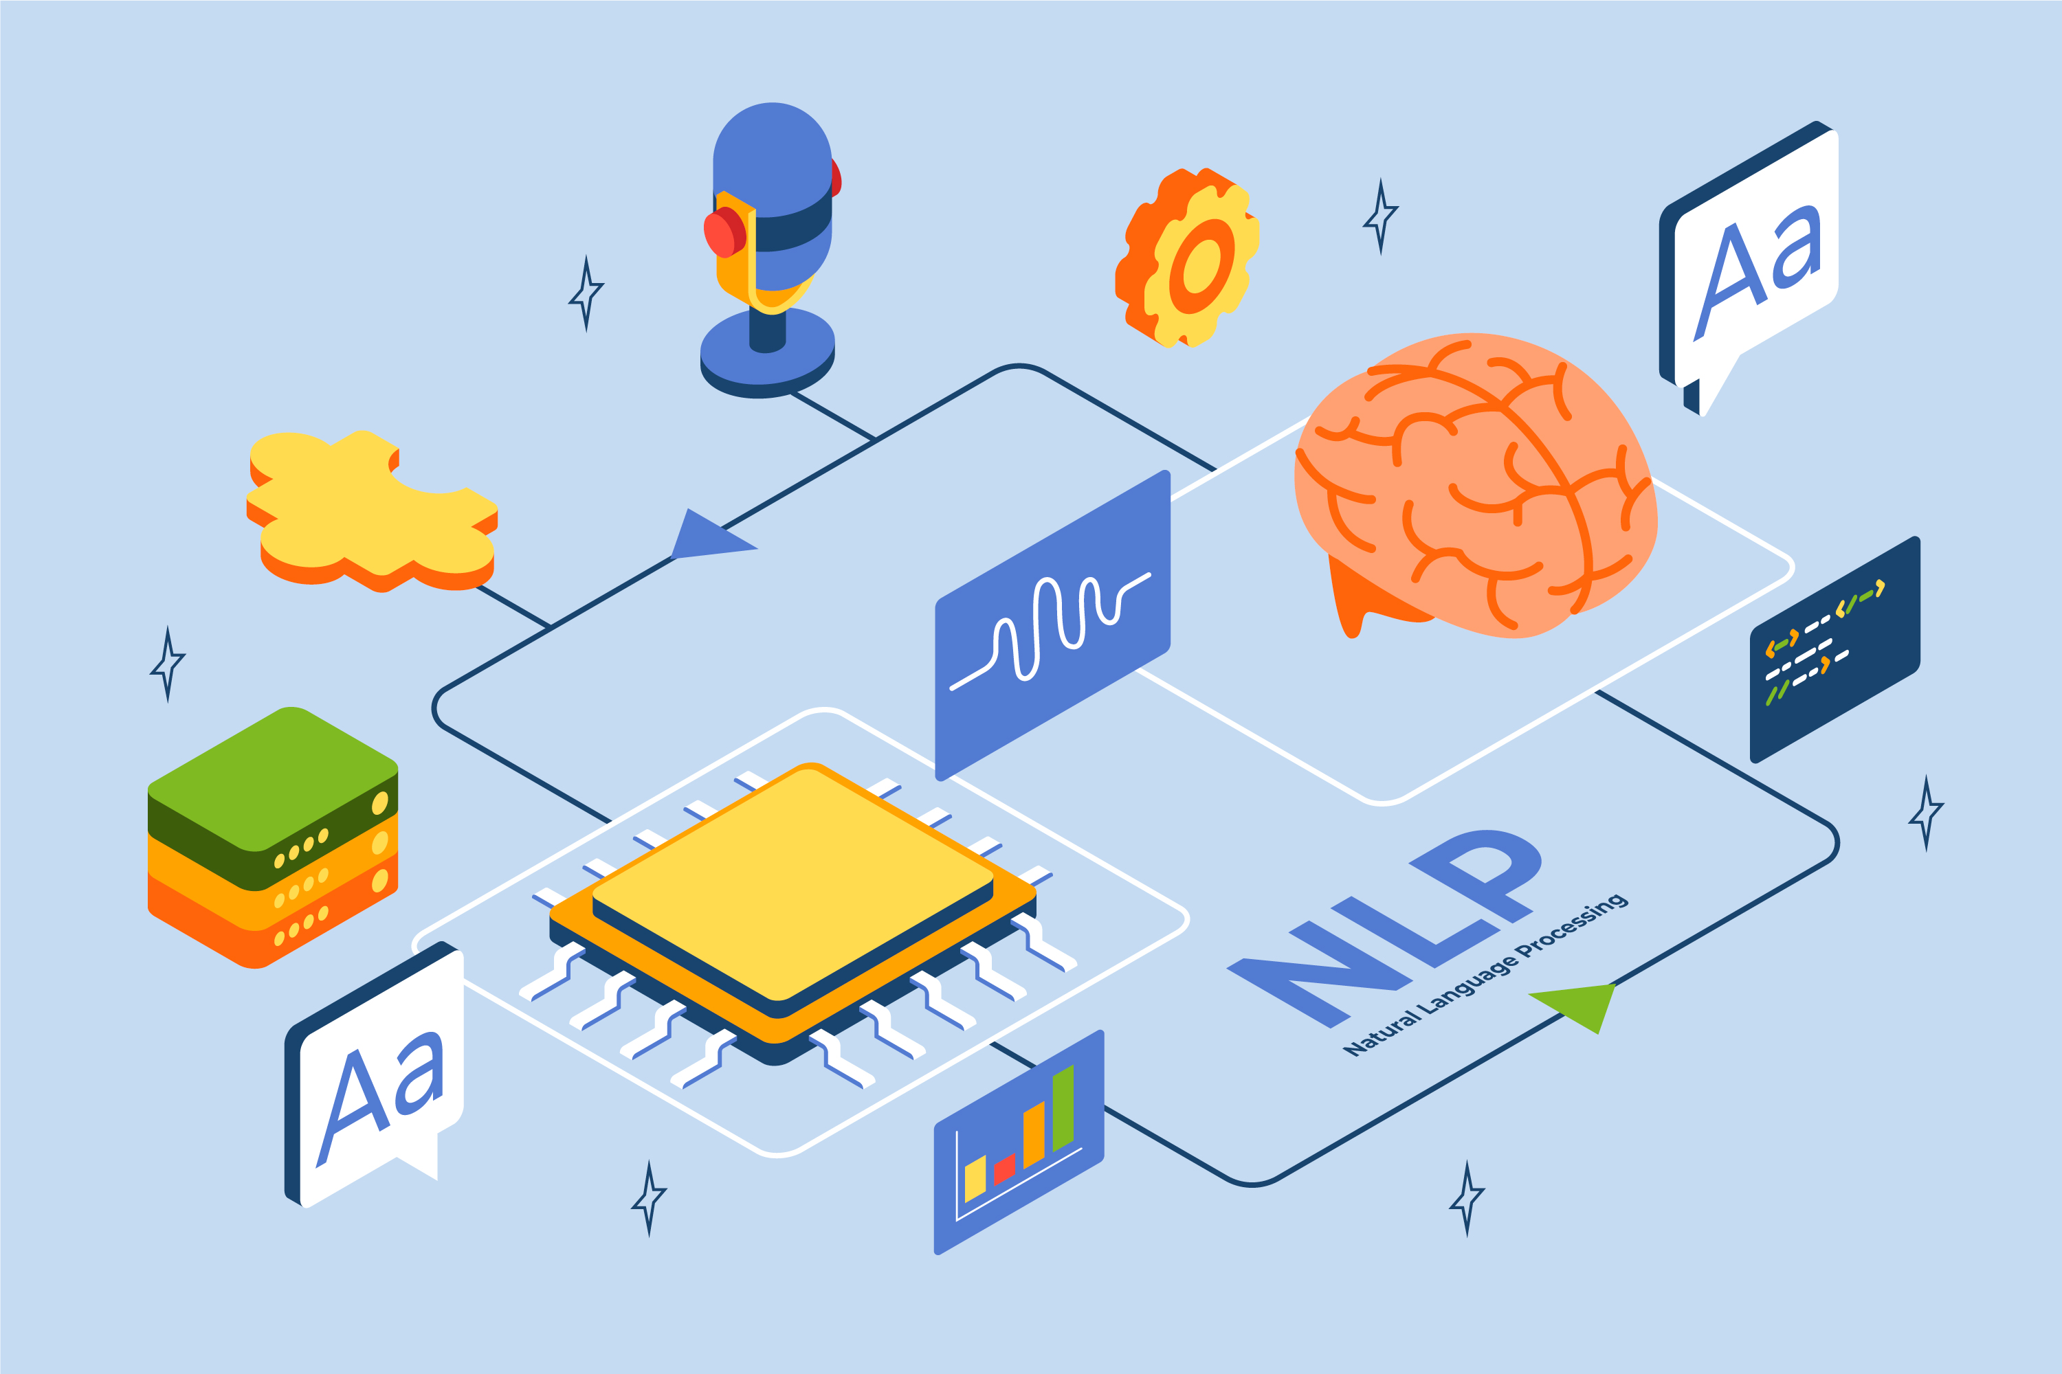

What Is Natural Language Processing?
Natural language processing (NLP) integrates computational linguistics and machine learning techniques. This combination is used to analyze the intricate components of language.
NLP encompasses the analysis of natural language datasets employing:
rule-based approaches,
probabilistic methods, or more recently
neural network-based approaches.

Slide 8
Levels of Natural Language Processing
Natural language processing (NLP) techniques use different linguistic levels for comprehending and utilizing language, providing an explanatory method for NLP systems.
Levels of language
Lexical or morphology
Word formation
Syntax
Structure of clauses and sentences
Semantics
Meaning of various kinds
Discourse integration
Contextualization
Pragmatics
Language use

Slide 9



Natural Language Processing Components
Natural language processing (NLP) is often used as an umbrella term to include :
Natural language understanding (NLU)
Interprets intent behind the input text
Natural language generator (NLG)
Focuses on text generation, or the construction of text
NLP
Dialog Management (DM)
Determines the actual context of the dialogue and offers state and flow of the dialog to make the conversation human-like

Slide 10
Real-World Application of NLP

Slide 11

Applications of NLP
Natural language processing (NLP) comprises a wide range of tasks and application. These include:
Sentiment analysis
Sentiment analysis involves determining the sentiment expressed in a piece of text.
Text classification
Speech recognition
Language modelling
Chatbots and virtual assistants

Slide 12
Applications of NLP
Natural language processing (NLP) comprises a wide range of tasks and application. These include:
Sentiment analysis
Text Classification involves categorizing or assigning predefined labels to text documents based on their content.
Text classification
Speech recognition
Language modelling
Chatbots and virtual assistants

Slide 13
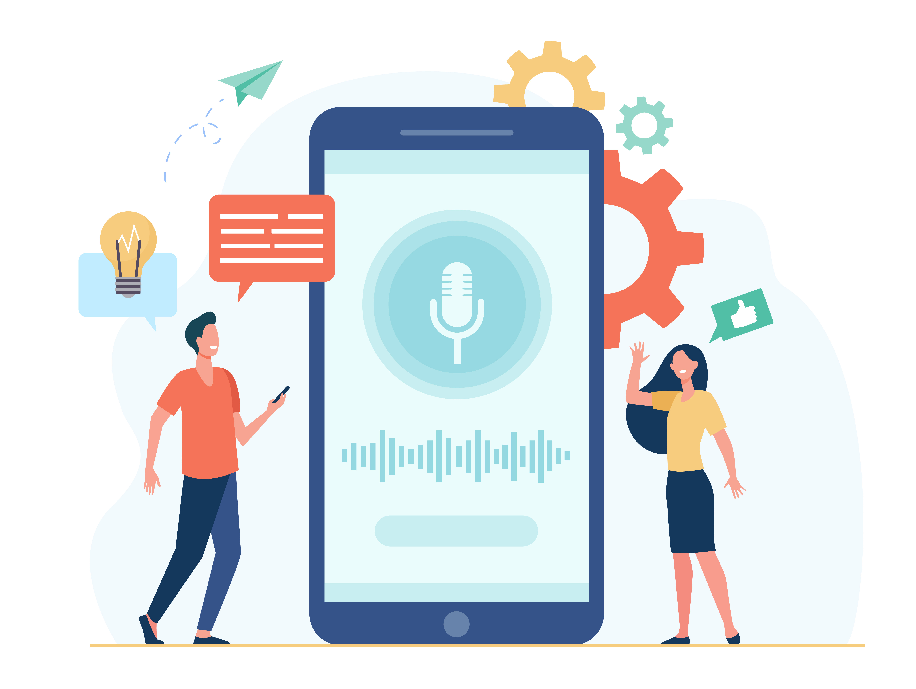
Applications of NLP
Natural language processing (NLP) comprises a wide range of tasks and application. These include:
Sentiment analysis
Speech recognition is a technology that converts spoken language into written text.
Text classification
Speech recognition
Language modelling
Chatbots and virtual assistants

Slide 14
Applications of NLP
Natural language processing (NLP) comprises a wide range of tasks and application. These include:
Sentiment analysis
Language modelling involves predicting the probability distribution of a sequence of words in a given language.
Text classification
Speech recognition
Language modelling
Chatbots and virtual assistants

Slide 15

Applications of NLP
Natural language processing (NLP) comprises a wide range of tasks and application. These include:
Sentiment analysis
Chatbots and virtual assistants are applications that use NLP and AI technologies to engage in conversations and provide information or perform tasks for users.
Text classification
Speech recognition
Language modelling
Chatbots and virtual assistants

Slide 16
Natural Language Processing Models

Slide 17
Popular Natural Language Processing Models
With ever increasing data size and the challenges, demand for more efficient and effective NLP models is inevitable. The following are some widely used pre-trained NLP models:
BERT
Bidirectional Encoder Representations from Transformers
ELMO
BERT is a powerful pre-trained NLP model introduced by Google researchers in 2018.
RoBERTa
It has significantly influenced the field of NLP and set new benchmarks for various language understanding tasks.
XLNet
ChatGPT-3

Slide 18
Popular Natural Language Processing Models
With ever increasing data size and the challenges, demand for more efficient and effective NLP models is inevitable. The following are some widely used pre-trained NLP models:
BERT
Embeddings from Language Models
ELMO
ELMo is a contextualized word embedding technique developed by researchers at the Allen Institute for Artificial Intelligence (AI2).
RoBERTa
ELMo generates dynamic embeddings, thereby capturing more nuanced meanings and context-specific information in language.
XLNet
ChatGPT-3

Slide 19
Popular Natural Language Processing Models
With ever increasing data size and the challenges, demand for more efficient and effective NLP models is inevitable. The following are some widely used pre-trained NLP models:
BERT
Robustly optimized BERT approach
ELMO
It is a variation of the BERT model, introduced by Facebook AI Research (FAIR) in 2019.
RoBERTa
RoBERTa aims on addressing some limitations and improving the performance of BERT.
XLNet
ChatGPT-3

Slide 20
Popular Natural Language Processing Models
With ever increasing data size and the challenges, demand for more efficient and effective NLP models is inevitable. The following are some widely used pre-trained NLP models:
BERT
XLNet
ELMO
XLNet is a transformer-based language model introduced by Google AI and Carnegie Mellon University researchers in 2019.
RoBERTa
It also builds upon the architecture of BERT and incorporates additional innovations to overcome some limitations.
XLNet
ChatGPT-3

Slide 21
Popular Natural Language Processing Models
With ever increasing data size and the challenges, demand for more efficient and effective NLP models is inevitable. The following are some widely used pre-trained NLP models:
BERT
Chat Generative Pre-trained Transformer 3
ELMO
ChatGPT-3 is a language model developed by OpenAI.
RoBERTa
It is the third iteration in the GPT series and is known for its impressive language generation capabilities.
XLNet
ChatGPT-3

Slide 22
Challenges of NLP

Slide 23


Challenges in Natural Language Processing
Though NLP has made notable progress, there are still several challenges that persist in this field.
These include:
Ambiguity
Language variability
Understanding language can be challenging due to the ambiguity of words, which can have multiple meanings.
Sarcasm and irony
Hence, trying to figure out exactly what someone means is a big challenge in NLP.
Lack of contextual understanding

Slide 24
Challenges in Natural Language Processing
Though NLP has made notable progress, there are still several challenges that persist in this field.
These include:
Ambiguity
Language variability
Variation in languages across dialects and accents pose challenge in developing an NLP model.
Sarcasm and irony
The limited usage of certain languages is also a significant challenge in the implementation of NLP.
Lack of contextual understanding

Slide 25
Challenges in Natural Language Processing
Though NLP has made notable progress, there are still several challenges that persist in this field.
These include:
Ambiguity
Language variability
Machines face challenges in dealing with the intricate mechanisms of human language.
Sarcasm and irony
For example, recognizing sarcasm or irony is often not within the capabilities of most NLP models.
Lack of contextual understanding

Slide 26
Challenges in Natural Language Processing
Though NLP has made notable progress, there are still several challenges that persist in this field.
These include:
Ambiguity
Language variability
Words can vary in meaning based on context, and some words, despite similar pronunciation, may carry different meanings.
Sarcasm and irony
This creates trouble for speech-to-text systems and, subsequently, NLP models.
Lack of contextual understanding

Slide 27
Python Libraries of NLP

Slide 28
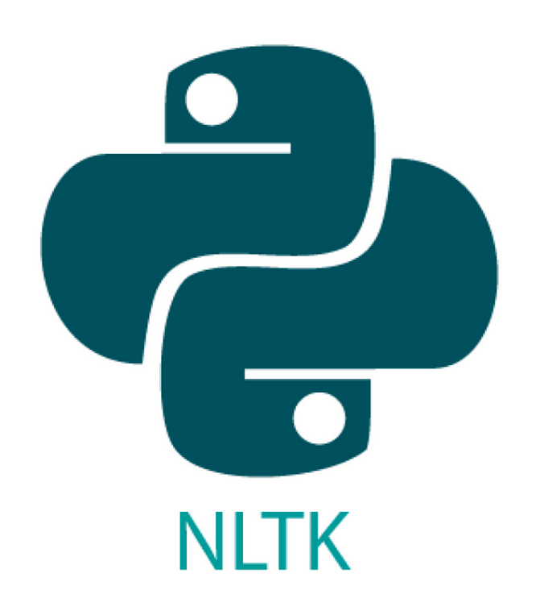






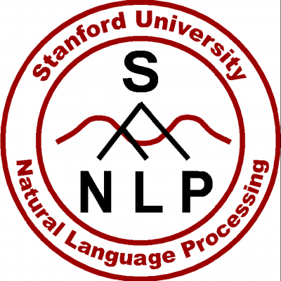


NLP using Python
Python is a powerful tool for implementation of NLP. It offers a wide range of tools and libraries within its ecosystem to facilitate NLP tasks.
Here are some of the most well-known packages for NLP implementation in Python:

Slide 29
Natural Language Processing (NLP) is a specialized branch of AI that focuses on interaction between computers and human language.
NLP is utilized in various real-world applications such as sentiment analysis, text classification, speech recognition, and chatbots, etc.
NLP comprises natural language understanding, dialog management, and natural language generation.
Few of the popular pre-trained NLP models include BERT, ChatGPT-3, RoBERTa, and ELMo.
Python supports several packages for the implementation of NLP tasks, which include NLTK, TextBlob, spaCy, gensim, polyglot, and flair.

Slide 31
A specialized branch of AI that focuses on interaction between computers and human language is called __________________.
1
Neuro Linguistic Programming
Natural Language Processing
A and B both
None of the above

Slide 32
A specialized branch of AI that focuses on interaction between computers and human language is called __________________.
1
Neuro Linguistic Programming
Natural Language Processing
A and B both
None of the above
B
Natural language processing or NLP is a specialized branch of AI that focuses on interaction between computers and human language.

Slide 33
Which of these libraries in python help to implement natural language processing?
2
NLTK
spaCy
TextBlob
All of the above

Slide 34
Which of these libraries in python help to implement natural language processing?
2
NLTK
spaCy
TextBlob
All of the above
D
Python provides libraries such as NLTK, spaCy, and TextBlob to perform NLP tasks.

Slide 35
Which of these NLP models have been developed by the Google AI Team?
3
BERT
RoBERTa
XLNet
ChatGPT

Slide 36
Which of these NLP models have been developed by the Google AI Team?
3
BERT
RoBERTa
XLNet
ChatGPT
A,C
BERT and XLNet are powerful NLP models developed by the Google AI team.

Slide 37
Thank You!

